Slide 1

Comprehensive Customer Churn Analysis: From Exploration to Prediction
Utilizing Data Visualization, Dimensionality Reduction, Unsupervised Learning, and Machine Learning.
Group No. 25
Sanket Kulkarni (A20537896)
Ameya Hujare (A20545367)
Deep Pawar (A20545137)
Maram Reddy Srinath Reddy
(A20561409)
Prof: Oleksandr Narykov

Slide 2


PROBLEM STATEMENT
The telecom industry struggles with high customer churn, impacting revenue and growth. This project analyzes customer behavior, identifies churn factors, and develops predictive models using machine learning to empower companies with data-driven retention strategies.

Slide 3
OBJECTIVES
Analyze and predict customer churn for a telecommunications company using advanced data analysis and machine learning techniques.
Use advanced techniques (PCA, UMAP, t-SNE) to uncover patterns.
Apply clustering to identify customer groups.
Improve model accuracy with feature selection, regularization, and hyperparameter tuning.
Use insights to enhance retention strategies and boost revenue.

Slide 4
DATASET
Dataset Overview :
Total Records: Approximately 7,043 rows.
Features: 21 columns, including customer demographic, service subscription, and financial details.
Target Variable: Churn
Values: Binary (Yes/No) indicating whether the customer has churned.
Distribution: ~26.5% churned (Yes).
~73.5% retained (No).
Feature Categories :
Demographic Information: gender, Senior Citizen, Partner, Dependents.
Account Information: Tenure, Contract, Paperless Billing, Payment Method.
Service Information: Internet Service, Online Security, Device Protection, Streaming TV, etc.
Financial Information: Monthly Charges, Total Charges.

Slide 5
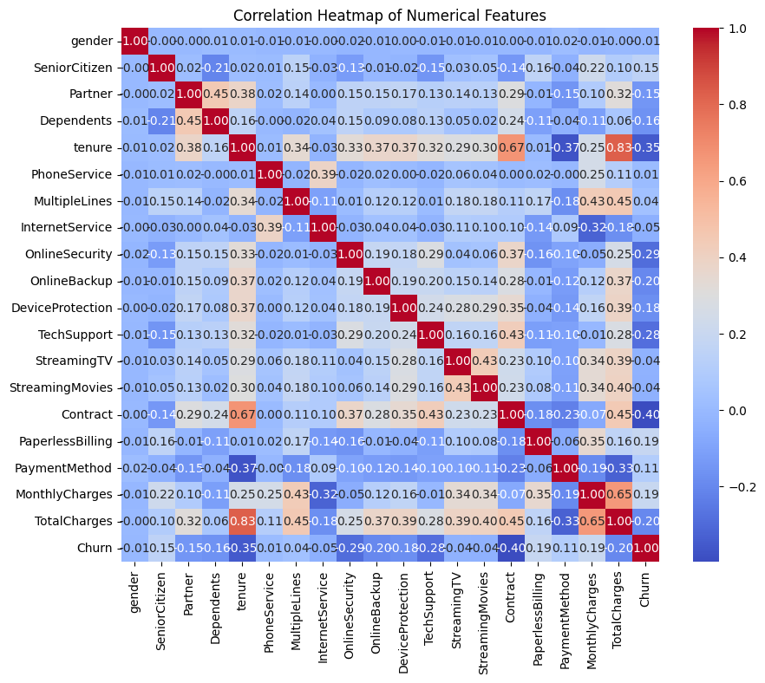
DATA EXPLORATION
Correlation Analysis:
Heatmap showing relationships among numerical features (e.g., tenure, monthly charges).
Notes:
Here, Heatmap shows a strong correlation between MonthlyCharges and TotalCharges.
tenure negatively correlates with Churn, suggesting loyal customers are less likely to churn.

Slide 6
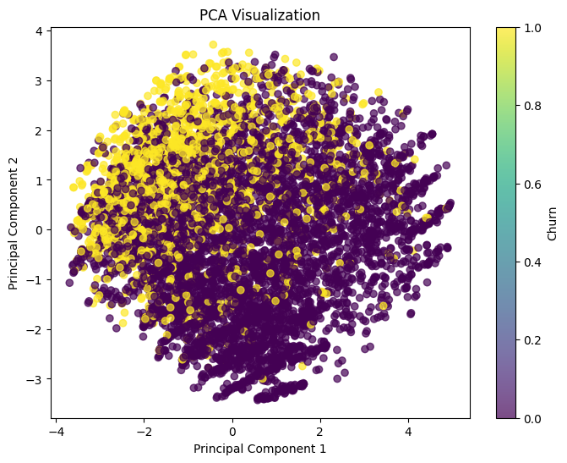
VISUALIZATION STRATEGIES
Techniques Used:
1. PCA: Visualizing feature variance patterns. Captures most variance in the first two components, useful for linear patterns.
Notes:
Insights: PCA shows linear patterns, while UMAP and t-SNE reveal nonlinear clustering.

Slide 7
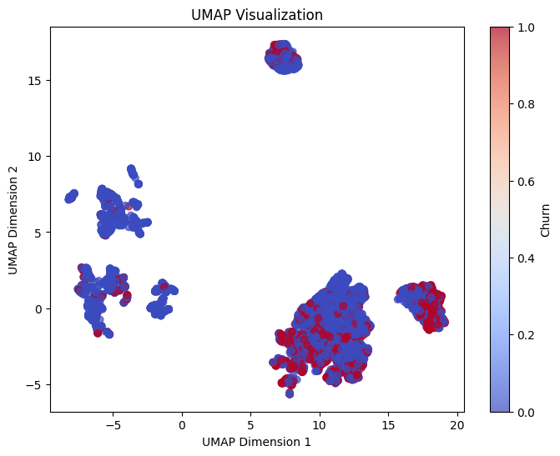
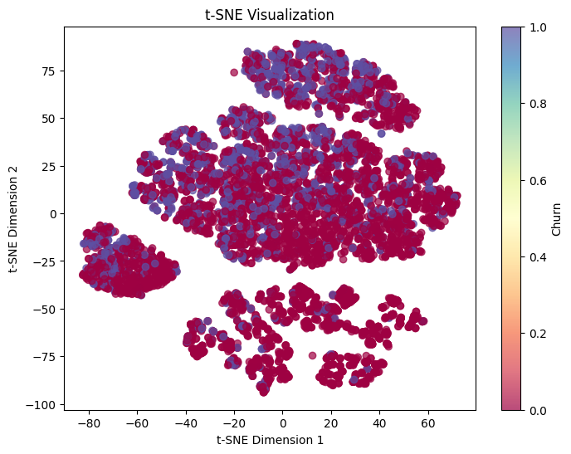
VISUALIZATION STRATEGIES
2. UMAP and t-SNE: Highlights clustering tendencies and local feature separability. Unveils nonlinear clusters and separations in customer segments.
Notes:
Insights: Customers with longer tenures and higher charges cluster distinctly, indicating loyalty patterns.

Slide 8
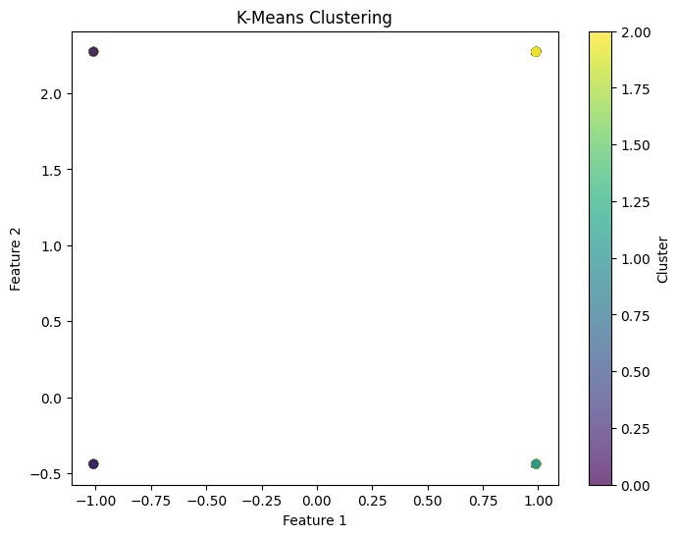
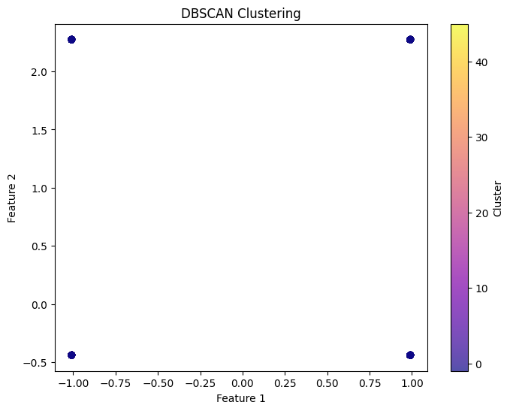
UNSUPERVISED LEARNING
Techniques:
1. DBSCAN: Identified clusters of similar customers.
2. K-Means: Optimized with silhouette scores.
Notes:
Key customer segments are identified based on tenure and charges.

Slide 9
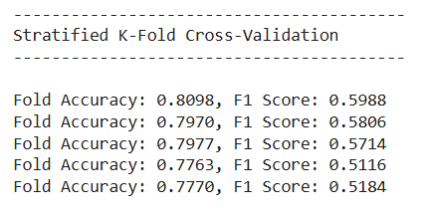
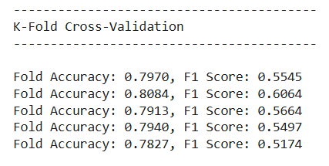
CROSS-VALIDATION
1. Stratified K-Fold Cross-Validation:
Ensures each fold of the dataset has the same proportion of target classes (Churn: Yes and No) as the original dataset, which is critical for imbalanced datasets.
2. K-Fold Cross-Validation:
Splits the dataset into k equal parts, but does not ensure proportional distribution of target classes.

Slide 10
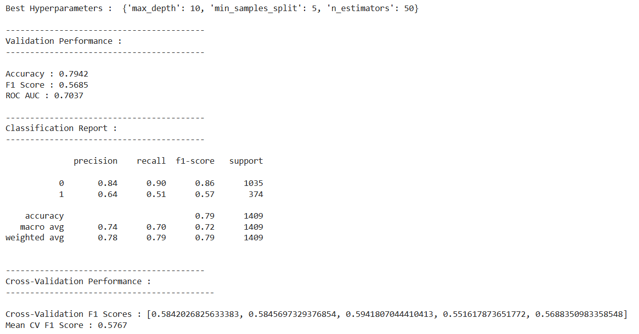
MODEL TRAINING
Model Training:
1. Random Forest classifier trained using Stratified K-Fold Cross-Validation.
2. Hyperparameter tuning (e.g., max depth, number of estimators) using GridSearchCV resulted in optimal model performance.

Slide 11
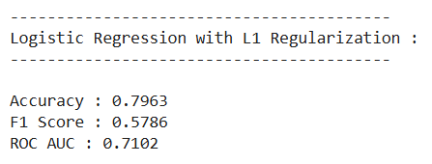
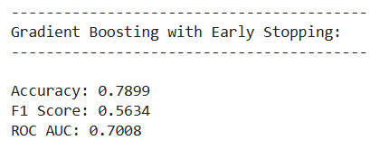
PROPOSED PERFORMANCE IMPROVEMENTS
Techniques:
1. Regularization (L1 penalty in Logistic Regression) to reduce overfitting.
2. Early stopping in Gradient Boosting to enhance model robustness.

Slide 12
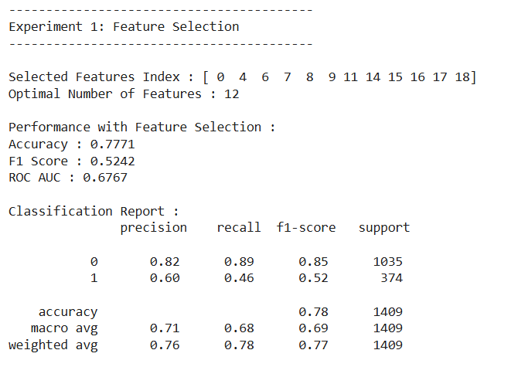
EXPERIMENTS CONDUCTED
Experiment 1:
Feature Selection using Recursive Feature Elimination (RFE) to improve model interpretability and training efficiency by selecting only the most relevant features, reducing noise and redundancy.

Slide 13
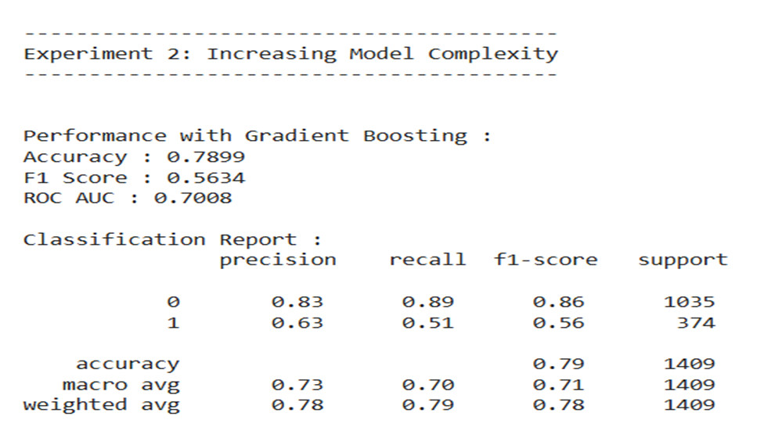
EXPERIMENTS CONDUCTED
Experiment 2:
Increasing Model Complexity using Gradient Boosting to enhance predictive performance by capturing complex, nonlinear relationships in the data.

Slide 14
CONCLUSION
This project highlights critical factors influencing telecom customer churn, such as contract type, tenure, and monthly charges. Advanced visualization (PCA, UMAP, t-SNE) uncovered clustering patterns, while Gradient Boosting models excelled in churn prediction. These insights enable targeted, data-driven retention strategies, reducing churn and enhancing customer loyalty.

Slide 15

Thank You!!

